Slide 1

Agile Development & Scrum Framework
A comparison of Agile and waterfall
Connor Iles
23 February 2025

Slide 2
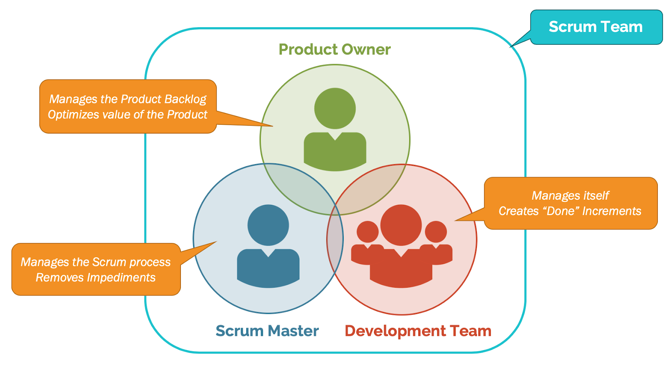
Agile Roles
https://nulab.com/learn/project-management/quick-guide-scrum-roles-responsibilities/

Slide 3
Agile Phases in SDLC
Concept & Initiation
Define vision for the project as well as requirements from stakeholders such as user-interface needs.
Planning
Develop a backlog for the product, sprint goals are established, user stories created.
Execution
Development ensures there are steps laid out to reach the end goal of the project.
Testing
Team continues to collaborate with stakeholders to ensure product meets high-end requirements.
Maintenance/Release
Product is deployed, take initial feedback, and curbed to meet new user/stakeholder needs.
Retirement
Product is obsolete and has no further use.

Slide 4
Waterfall vs. Agile
Feature | Waterfall | Agile
Process | Structured Cycles | Adaptive Cycles
Flexibility | Strict, Changes Delay Project | Adaptive for Fluid Needs
Feedback | Tested Late | User Feedback Frequent
Collaboration | Individuals responsible for their scope. | Team is functional, able to work together and adapt together
Customer | Minimal besides project start and completion | Customer input is constant

Slide 5
Waterfall or Agile?
When to use Agile:
Based on experience, you should use Agile when you receive a project that is expected to be heavily dynamic and requires constant changes.
There is need for constant user feedback
Project will require in depth collaboration between team members.
Development cycle is short
When to use Waterfall:
The project is rigid, goals and requirements will not change.
Project has a strict schedule dictated for you
Project you are developing requires a lot of documentation for compliance reasons
Large project is too large to not function without a strict timeline.

Slide 6
Conclusion
Overall,
Agile has the benefit of flexibility, intra-team collaboration making it the recoomended route for dynamic projects.
Waterfall is best used for large, sequential projects.

Slide 7
Works Cited
Guthrie, G. (2021, January 22). A quick guide to scrum roles and responsibilities. Nulab. https://nulab.com/learn/project-management/quick-guide-scrum-roles-responsibilities/
Lockhart, L. (2023, February 15). Agile vs. Waterfall: 10 Key Differences Between the Two Methods. Www.float.com. https://www.float.com/resources/agile-vs-waterfall
Radigan, D. (2024). Agile vs. waterfall project management. Atlassian. https://www.atlassian.com/agile/project-management/project-management-intro
Zhezherau, A. (2022). The Agile Software Development Life Cycle | Wrike Agile Guide. Wrike. https://www.wrike.com/agile-guide/agile-development-life-cycle/

